Slide 1
Random Forest
Object-oriented mapping of urban trees using Random Forest classifiers
Daniel Kadyrov
CS559 – Machine Learning
Spring 2020
Presentation #3

Slide 2
Agenda
Puissant, Anne & Rougier, Simon & Stumpf, Andre. (2014). Object-oriented mapping of urban trees using Random Forest classifiers. International Journal of Applied Earth Observation and Geoinformation. 26. 235–245. 10.1016/j.jag.2013.07.002.
https://www.researchgate.net/profile/Andre_Stumpf/publication/259124894_Object-oriented_mapping_of_urban_trees_using_Random_Forest_classifiers/links/5caf31ea299bf120975ddc2c/Object-oriented-mapping-of-urban-trees-using-Random-Forest-classifiers.pdf
Introduction
Study Site and Data
Method
Results and Discussion
Conclusion

Slide 3
Introduction
Many European cities enacted policies to track land cover use regarding vegetation
Topographical databases are rarely updated
Mapping of urban trees is difficult and expensive.
Unsupervised and supervised per-pixel algorithms have been proposed to analyze very high resolution (VHR) satellite image.
Peterson et al., 2004; Tooke et al., 2009
Per-pixel classifications based on spectral characteristics alone are insufficient
Tuominen and Pekkarinen, 2005; Sheeren et al., 2009
Object-based image analysis (OBIA) uses segmented images in homogenous regions and characterizes objects by spectral, spatial, and contextual properties.
Lang et al., 2006; Youjing and Hengtong, 2007; Mathieu et al., 2007; Pham and He, 2008; Tan and Wang, 2009; Vannier and Hubert-Moy, 2010

Slide 4
Introduction
Random Forest classification has shown high accuracy, robustness against over-fitting training data, and integrates measures of variable importance.
Diaz-Uriarte and Alvarez de Andres, 2006
RF is bias prone when the number of instances is distributed unequally among classes of interest (He and Garcia, 2009)
Objective: investigate the application and performance of Random Forest learning algorithms with object-oriented approach.

Slide 5
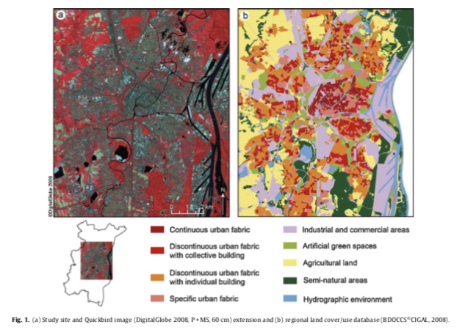
Study Site and Data
Study site and dataset
Strasbourg (North-east France)
Figure 1: multispectral bands (red, green, blue, near infrared).
Urban district (city center and suburbs) area of 142 km2.
Features wooded elements in public and private zones (hedges, group or isolated trees of different sizes, forest) and a river, the Rhine.
According to the available vegetation inventory databases, 19.8% is wooded vegetation.
=

Slide 6
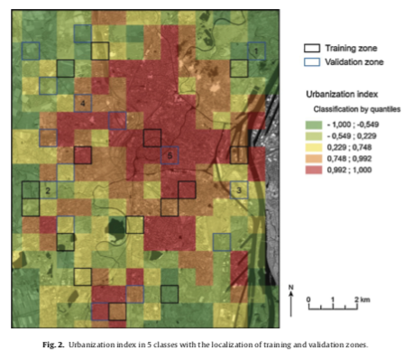
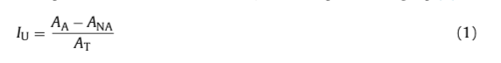
Study Site and Data
Construction of the training and validation datasets
The training set covers 5% of the image and is distributed over 15 stratified areas according to the urbanization index.
Grid size is 700 m x 700 m.
Urbanization index (I_u):
A_A: artificialized, A_NA: not artificialized, A_T: study area, 0.49 km2
I_u = -1 totally vegetated, I_u = 1 artificialized plots
Index classified into 5 plots
15 validation plots were chosen, 3 for each classification.

Slide 7
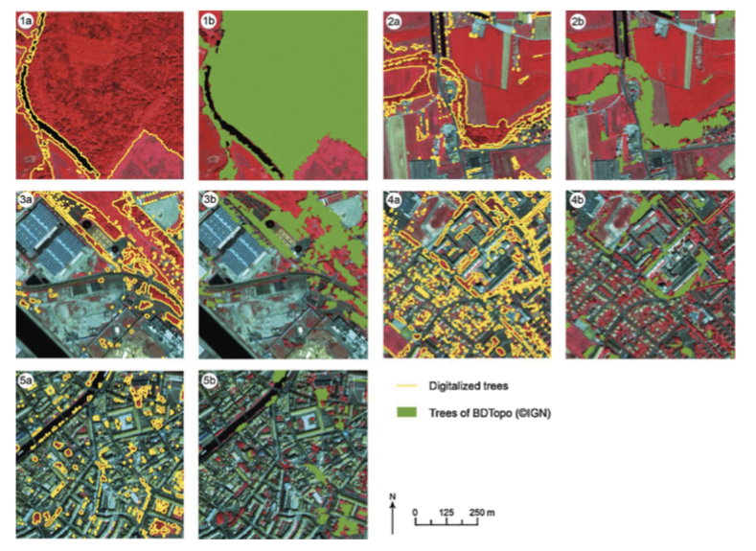
Method
Three Steps:
Segmentation and computation of object attributes
Algorithms are applied using the 4 multispectral bands and MSAVI index. Objective to improve and optimize classification procedure.
Test A: correct bias.
Test B: select more suitable metrics
Test C: modifies number of variables chosen for nodes.
Classification
Validation

Slide 8
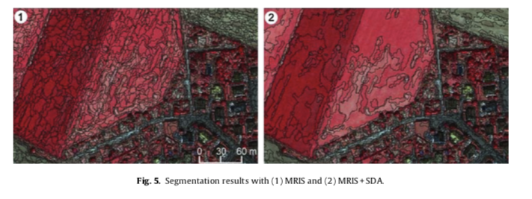
Method
Image Segmentation
Image segmentation generates regions
Delineation quality of the target images directly influences the accuracy of image classifier.
Algorithms have been developed to delineate homogenous and meaningful segments.
Multi-resolution image segmentation (MRIS): region growing algorithm that merges adjacent pixels or regions based on a criterion (object size, color, weight).
Over segmentation is preferable in the context of supervised classification since it enables small objects (Duro et al., 2012a; Smith, 2010; Stumpf and Kerle, 2011).
Spectral Difference Algorithm (SDA): merges neighboring objects based on the mean layer intensity values and user-defined maximum thresholds.
Each segment, 100 objects features for classification of wooden elements are computed including spectral, shape, texture, and attributes.

Slide 9
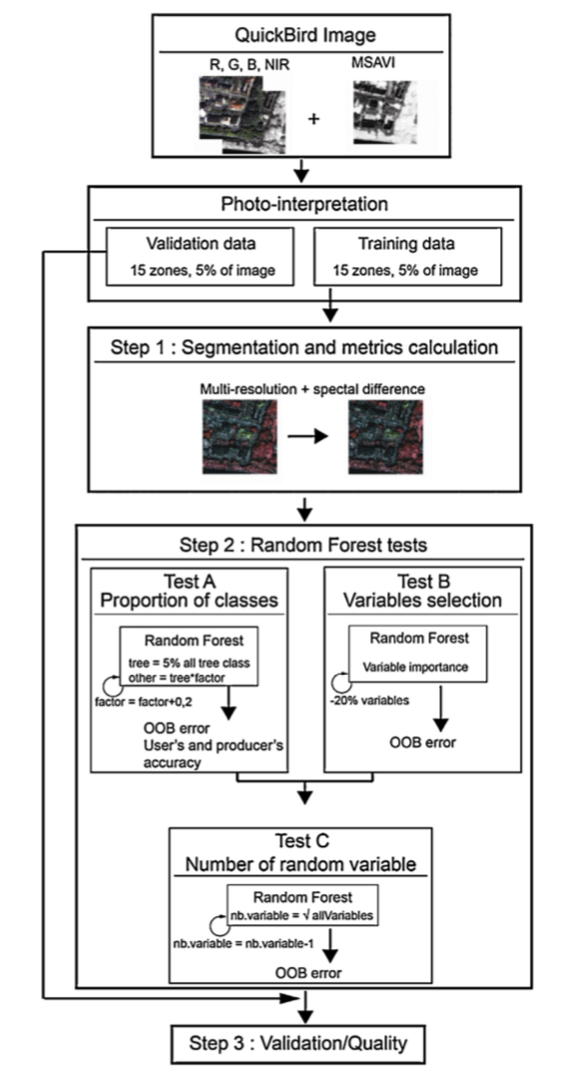
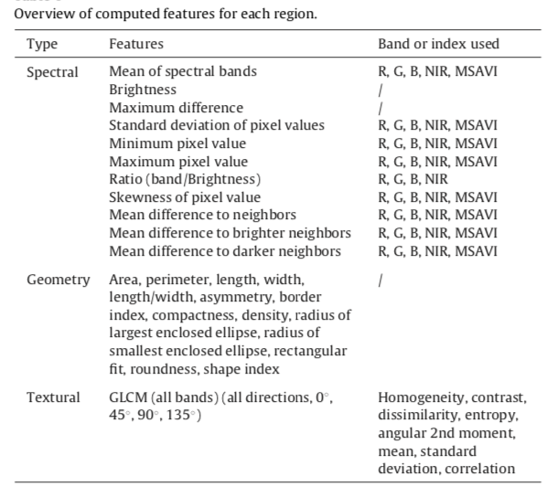
Method
Image Segmentation

Slide 10
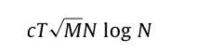
Method
Image Classification: Random Forest (RF)
RF is a supervised machine learning algorithm for regression and classification.
Multiple decision tree classified based on classification and regression tree (CART)
Performs bootstrap sampling and enables the calculation of an error estimate on the instances remaining out of the bag (OOB) on each tree.
Does not consider all variables at each node to determine the best split threshold but a random subset of the original set of features.
Number of variable nodes is set to the square root of the total number of variables but can be adjusted by user.
The number of trees must be sufficiently large to capture the full variability of the data and yield classification accuracy.
Final class is assigned to an object based on the majority vote of all trees in the forest.
The RF package in R was used.
Calculation time for training depends on constant complexity, number of trees, number of variables, and number of instances.
Each tree was built from a stratified bootstrap sample comprising only 5% of the training set.
Reduced computation time and memory requirements

Slide 11
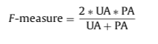
Method
Random Forest Tuning
Test A: Proportion of Classes
# Wooded elements < # Non-wooden elements
Iterative training and predicting on subsamples can avoid bias against the minority class.
Bootstrap samples corresponding to 5% of the wooded segments were multiplied by a factor. At first by 1, and the increased until reaching original class-ratio.
Test B: Variable Selection
First step, large number of trees (n=5000) were generated to measure variable importance.
New RFs are constructed by disregarding 20% of the least important variables.
OOB error is calculated and the model with the lowest error is selected.
Test C: Number of Random Variables
Square root of total number of variables by default.
Smaller number of random variables with a sufficiently large number of trees yields higher classification accuracy on a remote sensing dataset. (Gislason et al. (2006))
Final accuracy test is carried out comparing classification results at the 15 areas against mappings resulting from visual image interpretation.
Three accuracy measures are used, user accuracy (UA), producer accuracy (PA) and the F measure which allows to measure classification performance independence class imbalance.

Slide 12
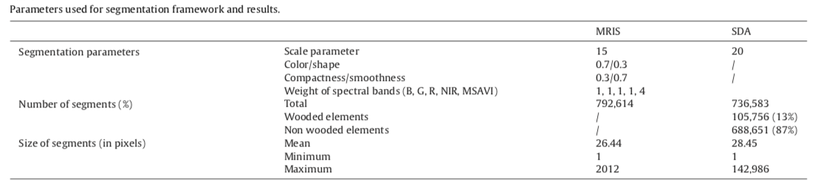
Results and Discussion
Segmentation Results
MRIS segmentation yielded less than 800,000 segments.
SDA reduced the segment number to 55,000 with increase mean size of segments and maximum size of segments.
Classes were assigned after the segmentation in a GIS (Geographic Information System). Number of segments does not correspond to sum of segments from both classes
Calculation of figures was intersected with the ground truth. Segmentation boundaries pixels followed the correctly generalized objects. Wooded elements represented 13%.

Slide 13
Results and Conclusion
Random Forest
Result of Proportion of Classes (Test A):
Showed bias between wooded and non-wooded elements. Non-wooded elements overrepresented.
Wooded elements 105,756 segments, Non-wooded elements 688,651 segments.
Proportion of wooded and non-wooded elements equalized by multiplying segment size by a factor until a balance is reached.
Result of Variable Selection (Test B):
7/8 MSAVI-based features/20 important variables
NIR bands were the lowest ranked attributes
80 features is the best possible solution for high accuracy prediction (but high computational costs.
33 attributes were selected.
Both a 33 and an 80-feature model were used.
Result of Number of Randomly Selected Variables (Test C):
For the construction of each 1000 trees, 5% of the wooded class segments are used.
33 and 80 feature models had similar results
Error reduction was 0.15
One variable per split yields a stronger decorrelation of individual trees in the forest and enhances the classification results.
Only used training data

Slide 14
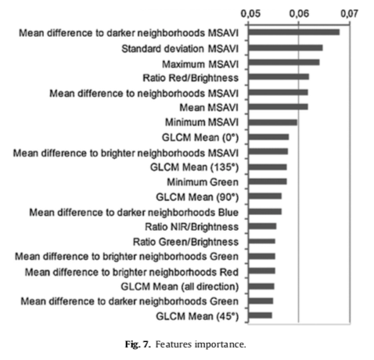
Results and Conclusion

Slide 15
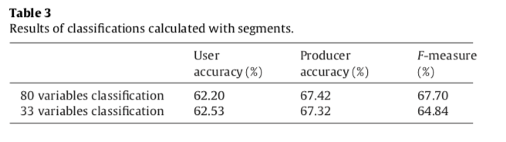
Results and Conclusion
Validation Step
Producer’s accuracy for “wooded” class higher than user’s accuracy by 5% for both classifications (33 and 80 feature)
F-measures were equivalent
Modeling 33 features presents better results and requires less computation time.
Accuracy performance of RF depends on urban fabric.
Small trees or little wedges cause omission errors.
Collective buildings like schools, hospitals also cause problems.
Shrubby vegetation, small gardens.

Slide 16
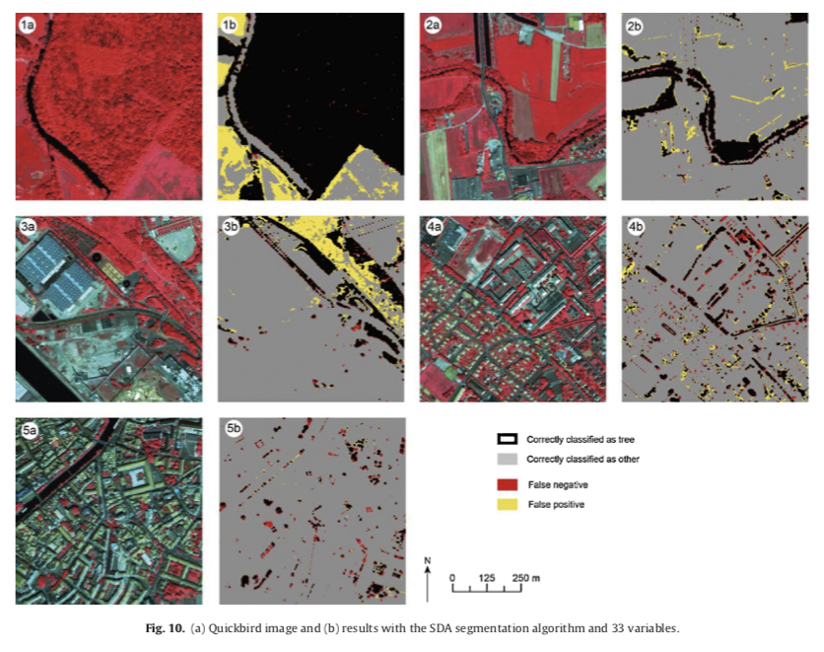
Results and Conclusion

Slide 17
Conclusion
Indexes from MSAVI were crucial for the classification of the images.
Random Forest classification proved to be robust to extract wooded vegetation.
Accuracy did not considerably change when changing class balance or included features.
Model was not sensitive to over fitting and all features could have been used.
Features were discarded for computational time; these features could have revealed their importance for classification
Does not require tuning of many parameters so it can identify urban vegetation efficiently.
Future Tests:
Active Learning: classifiers recommends iteratively the most valuable samples or for user to label areas.
Transfer Learning: reuse the clasifier and ground truth for classification of other images by adjusting the classifier to the changes.

